Slide 1
Stream Processing with Kafka and Python
Notes:
Today I am going to talk about stream processing in general and Kafka in particular; I will use Python to communicate with Kafka in our practical example.

Slide 2
What is it about?
Context: data engineering
Goal: make decision process less intuitive and more informed
Approach: datawarehouse
  Collect information in one place, process on schedule
  Make well-informed decisions using all of it
Approach: streaming
  Processing as a reaction to an event
  Make decisions as soon as possible
Notes:
First of all, I want to set a context.
The context of current presentation is data engineering. I will not talk about processing video or audio streams, neither about processing streams of UI events for example. To put it short, streams I will talk about consist of self-sufficient events. Every such event means something even if put aside from the rest.
Second, I want to set a goal - not for presentation, but for data engineering in general.
In my opinion, the goal is to improve decision process. Back it with facts derived from data, minimize the role of intuition, predict what happens in case of different outcomes, predict outcomes themselves.
One of the approaches is to create a datawarehouse.
Such datawarehouse would keep all our data in one place and help us to find answers to our questions. As all data needs to be in sync, we schedule processing pipelines and run them depending on each other, propagating results down the dependency tree.
The benefit of datawarehouse is that we enable generation of well-informed decisions, using all span of data available from the creation of the world up to the latest processing pipeline finished.
Another approach to reach the data engineering goal I would call streaming.
The difference from datawarehouse is that processing is handled as a reaction to an event, instead of starting on schedule. Remember what I told you about events in data engineering context?
The result of this paradigm shift is that my enabling stream processing, decisions can be made faster. There is no need to wait on datawarehouse pipelines to finish if you can figure out what to do basing on a shorter range of data.

Slide 3
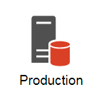

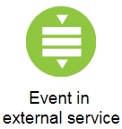
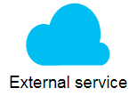
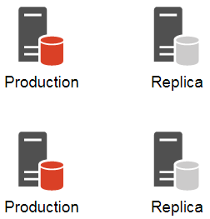
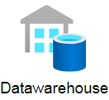
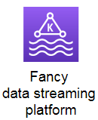
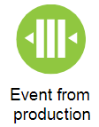

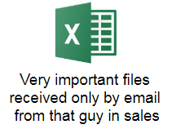

The story of data
Notes:
Now I will try to explain the same concept by showing pictures and telling stories. The story begins like this: once upon a time, there was a company.
This company had a product with a database, of course it was a production database. And this database could be very useful for extracting data for decision making, so engineers thought: why don’t we give readonly access to specific people who prepare business reports?
Well, soon engineers discover that reading directly from production is not the best idea. So they come up with having a replica for reading.
Then new products appear and each product has its own database. And of course, at least one replica for each production database.
To make things even more complex, a new external service appears that also knows something business wants to know as well. As company finishes integration with such service, it is also desirable to have integration with its data domain.
Of course, it’s not the worst thing that can happen. Sometimes, important knowledge comes from unexpected sources. Well, unexpected for engineers who have to work with that.
The first thing that comes to mind, is to create a separate storage of all that data - datawarehouse. Next step, build pipelines that read from sources and write into DWH.
Eventually, DWH becomes a source of truth where all data items are kept in sync with regularly running pipelines (if everything goes well).
Suddenly, one engineer visits a conference and comes up with a new concept - add a new fancy data streaming platform. So, how do they do it?
First, design events and their schemas. For production environment, developers are asked to emit events with certain structure once something important happens. Instead of reading all changes on schedule, changes come in a form of events.
For external service, there are several possibilities. If service provides webhook capabilities, it’s usually the best option. If not, one can always build a polling system that would fetch changes and emit events to the streaming platform.
For items coming from emails, engineers come up with idea of email reader that runs 24/7, parses incoming emails, reads files from attachments and emits events to the streaming platform.
Once engineers figure out enough approaches to feed their new shiny streaming platform with data, it can be actually used for business purposes and reliable decision making, thus becoming another source of truth, but for this time - short-term, in-the-moment truth. Which is nevertheless a valuable one.

Slide 4
Welcome to Kafka
Publish/subscribe messaging system
Unit of data is a message
  Similar to a row in relational databases
Message belongs to a topic
  Similar to a table in relational databases
Topic is split in partitions

Slide 5
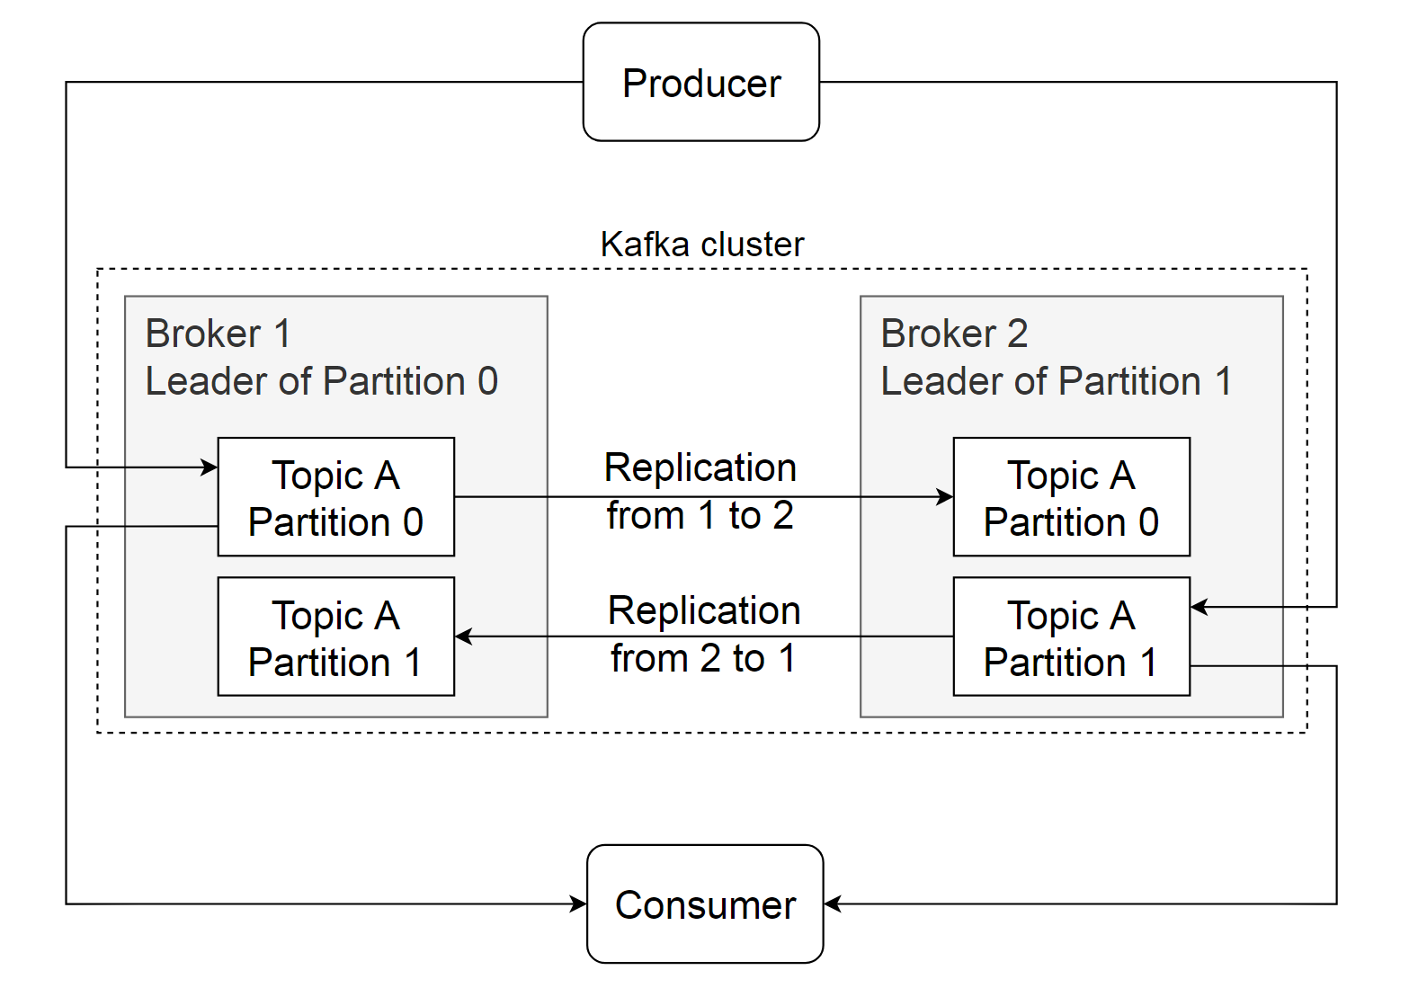
Why Kafka is called distributed?
Notes:
Kafka is a distributed system. Let’s figure out why and how it’s made like this.
A single Kafka server is called a broker. Broker exists inside a cluster and each broker can have multiple roles inside that cluster.
It is worth mentioning that you can have a cluster with only one broker and it will work fine. It is even possible to scale it up to as many brokers as needed.
So, each broker can have multiple roles. Within a cluster, one broker becomes a controller, elected automatically by other brokers currently online. Controller is responsible for administrative operations, like assigning partitions to brokers and monitoring for broker failures. It is not shown on this slide for the sake of simplicity.
What this slide illustrates is providing redundancy for messages in partitions. Nobody likes losing messages, and Kafka is built around the idea of minimizing that risk. As you can see, here we have one topic which is kept on 2 brokers - so, the replication factor equals 2. FYI this is not advised to have replication factor of 2 for production. As they say, keep your data in at least 3 places. So, the recommended replication factor for production is 3.
The tricky part about Kafka replication is that for one topic, different brokers can be called leaders of its partitions. The leader of partition is the broker that interacts with producers and consumers and always keeps the latest state of the partition. In case of broker unavailability, the leadership of its partitions can be transferred to other brokers with replicas.

Slide 6
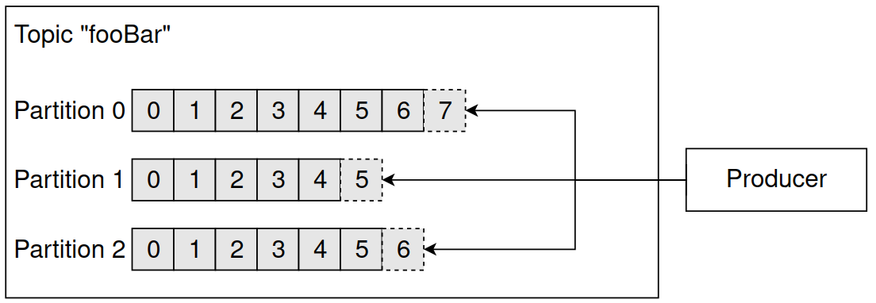
Writing to Kafka

Slide 7
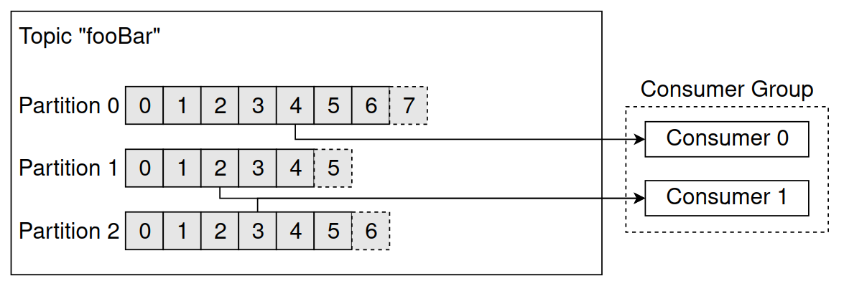
Reading from Kafka
Notes:
Tell about committing offsets for partitions.

Slide 8
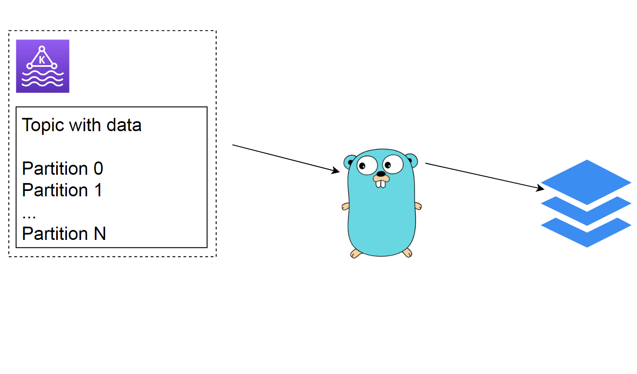
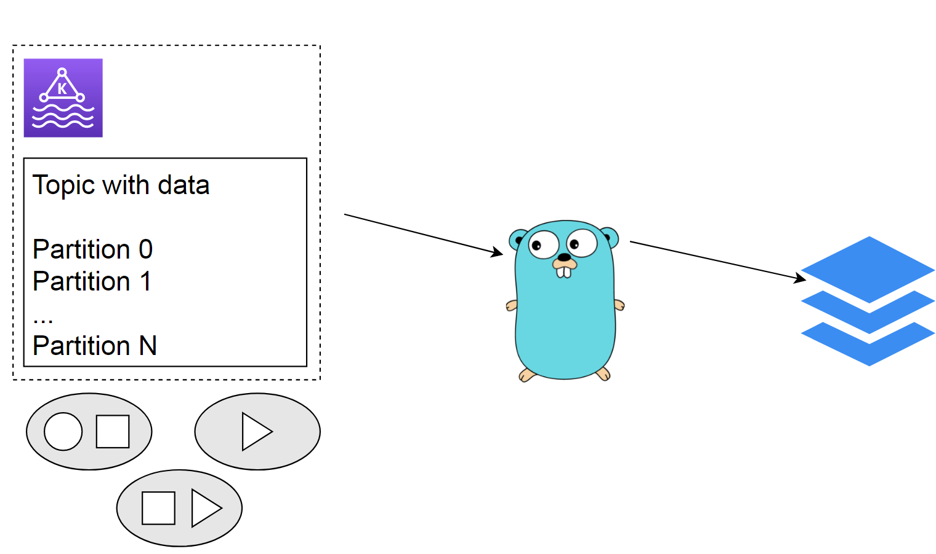
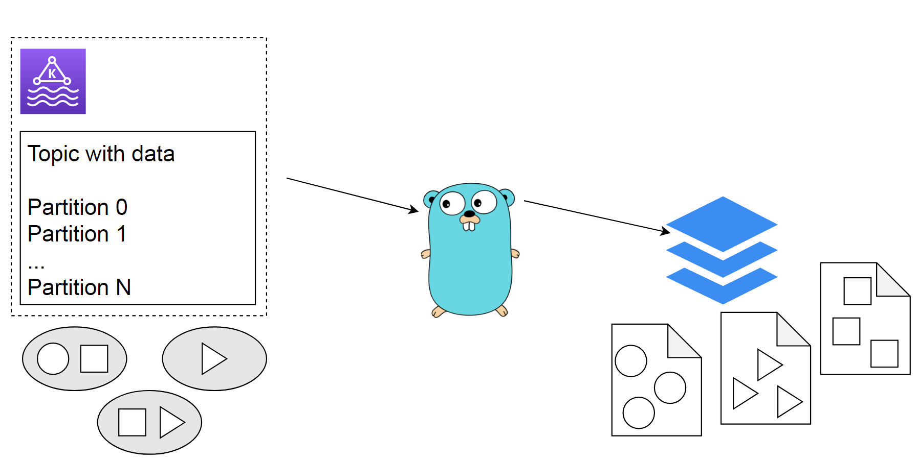
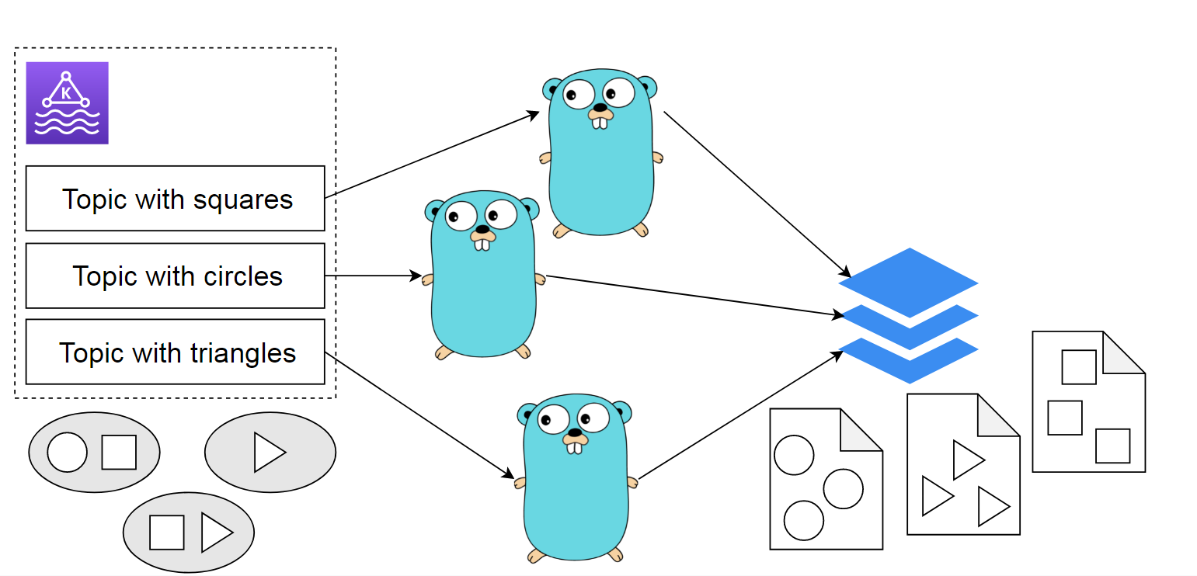
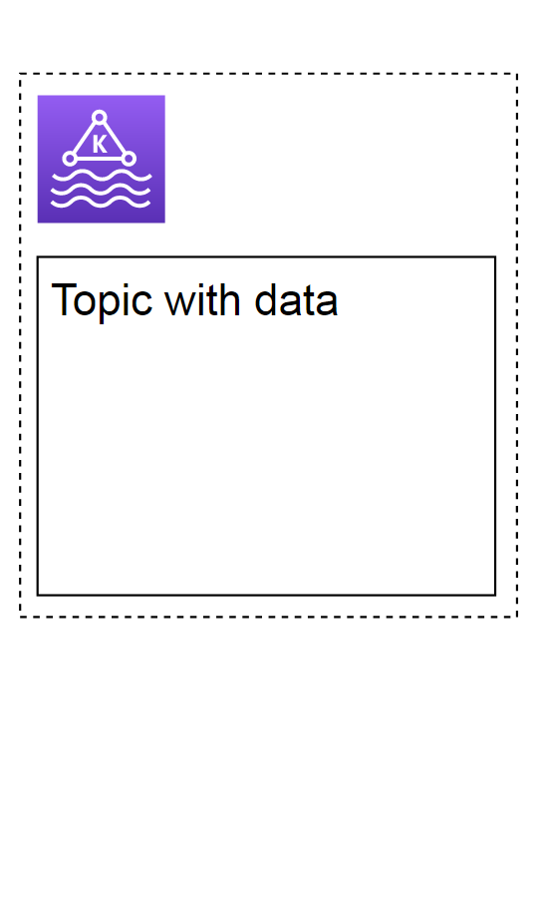
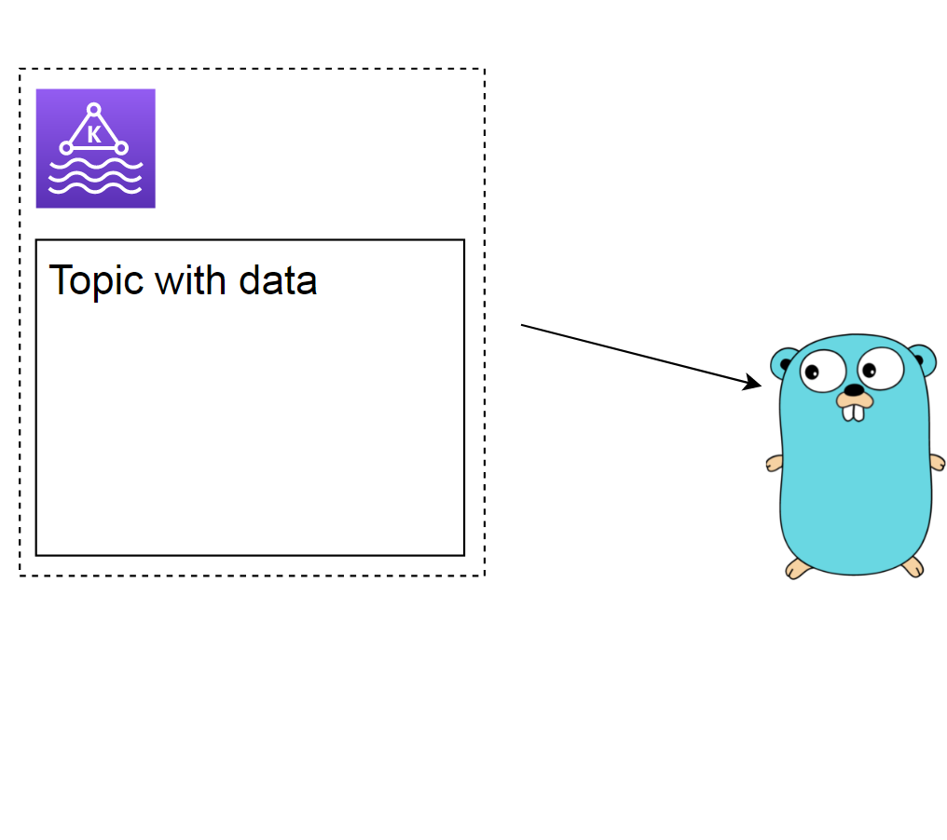
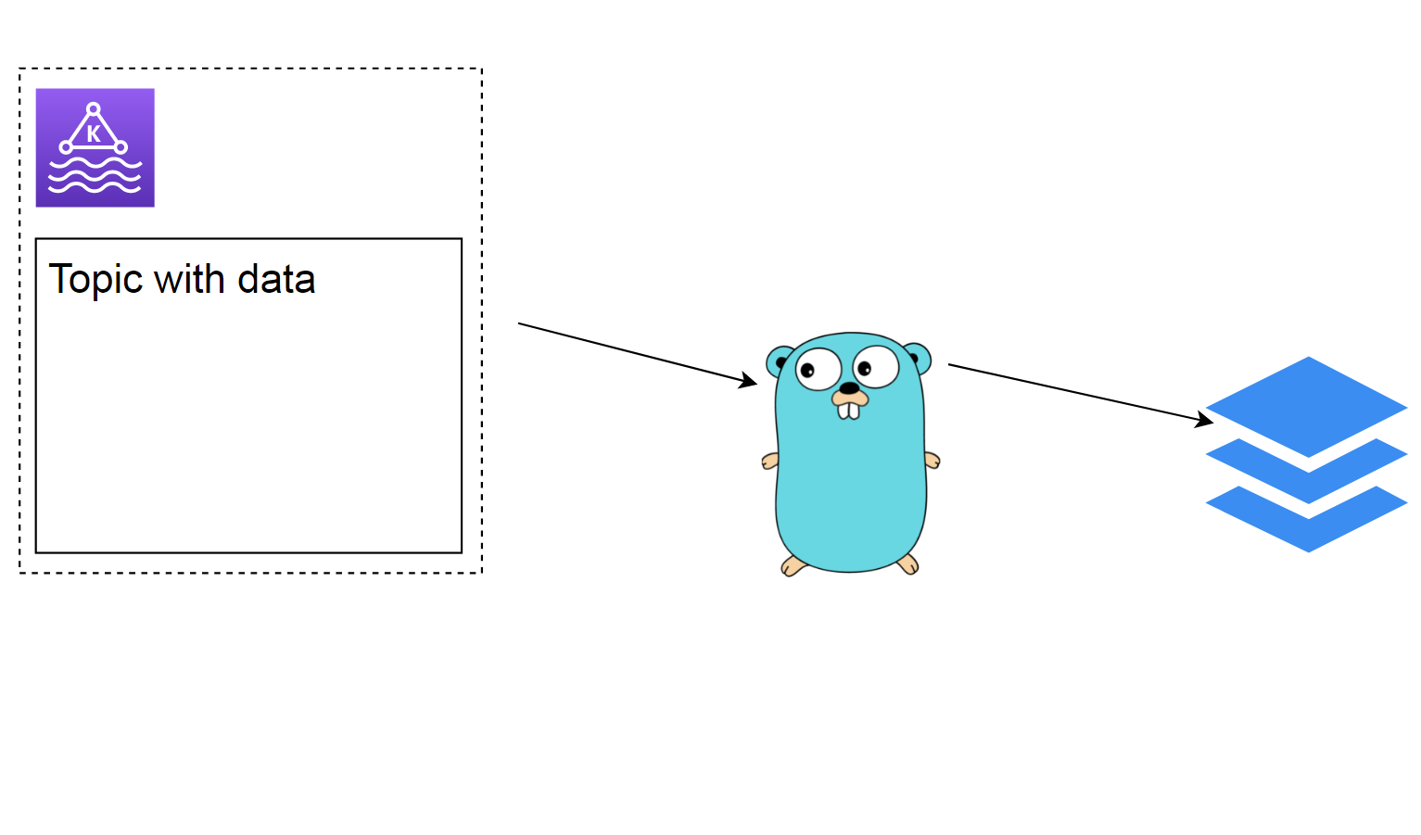
How to write messages to files and keep your mental health in shape

Slide 9
Configuration: topic
num.partitions
  Decide basing on future throughput vs consumer capacity
log.retention.ms and log.retention.bytes
log.segment.bytes and log.segment.ms
  Retention happens per segments
message.max.bytes
  Defaults to 1 Mb; beware of performance impact
  Adjust fetch.message.max.bytes and replica.fetch.max.bytes

Slide 10
Configuration: producer
acks configures desired delivery guarantee
  0 means fire and forget
  1 means leader replica received the message
  all means all in-sync replicas received the message
batch.size configures a tradeoff between latency and throughput
  Large batches increase maximum of messages per second
  Small batches decrease latency for a single message
linger.ms is the amount of time to wait before sending the batch
  Defaults to 0; use higher value to increase throughput

Slide 11
Configuration: consumer
auto.offset.reset controls handling of a new partition
  latest is the default option to read from newest records
  earliest means reading from the oldest records
enable.auto.commit can be true or false
partition.assignment.strategy defines how partitions are assigned to consumers
  Range strategy is the default one
  RoundRobin strategy provides more evenly distributed assignments
  Custom implementations are possible

Slide 12
Extending Kafka: Kafka Connect
Producer/Consumer APIs require programming
  Connecting Kafka with typical data sources should be easier
Kafka Connect is a tool for connecting Kafka with other systems
  Supports two types of connectors: source and sink
  Runs in distributed or standalone mode
  Uses Kafka itself as a backend to keep state
  Provides REST API to create connectors

Slide 13
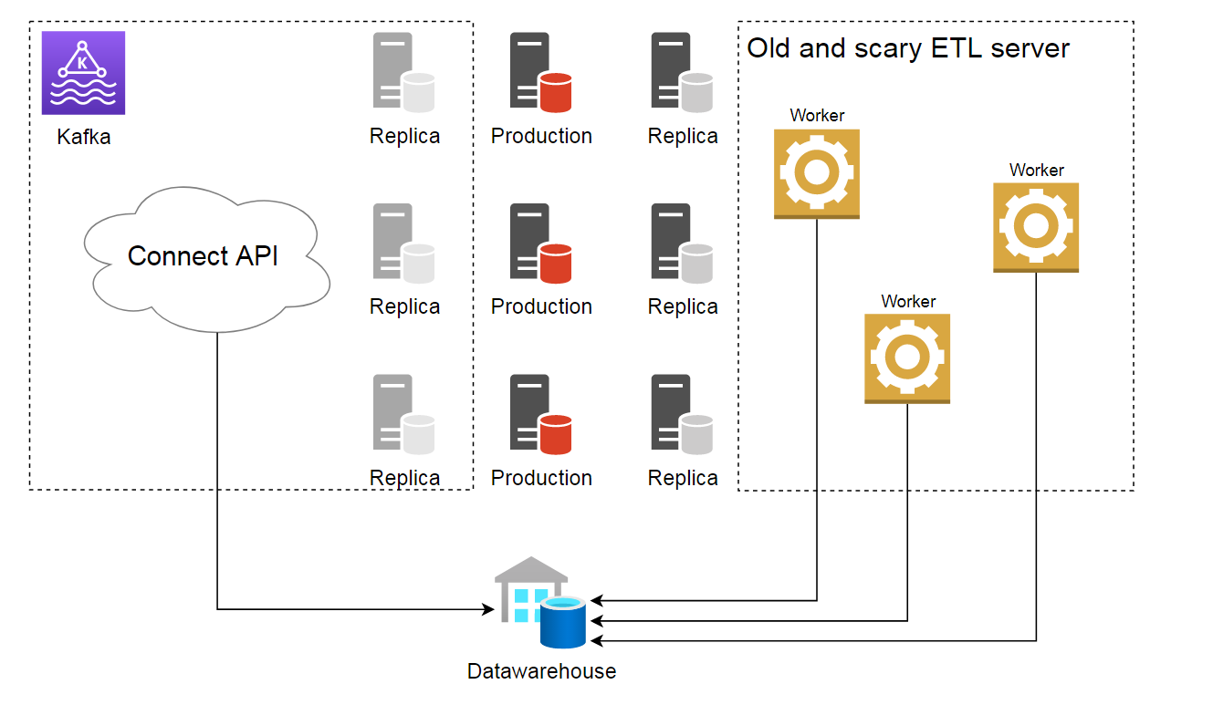
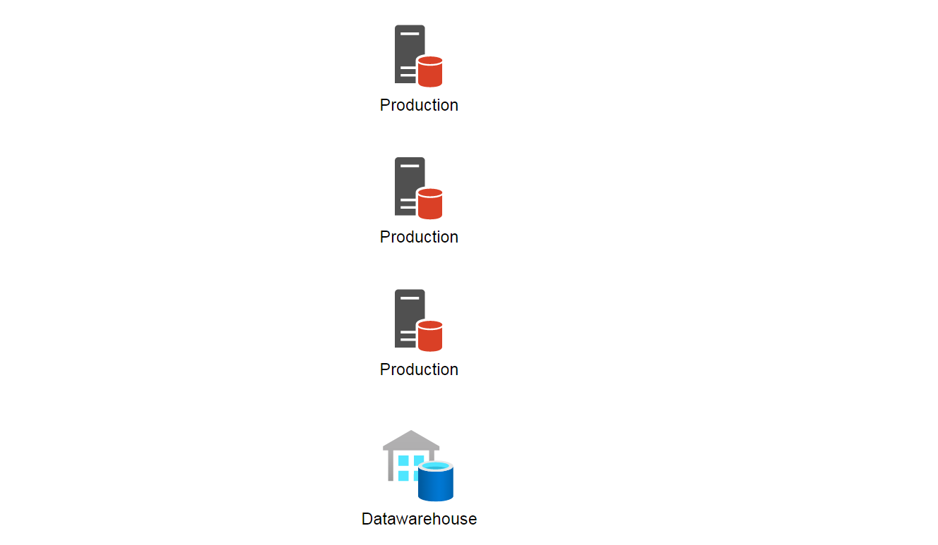
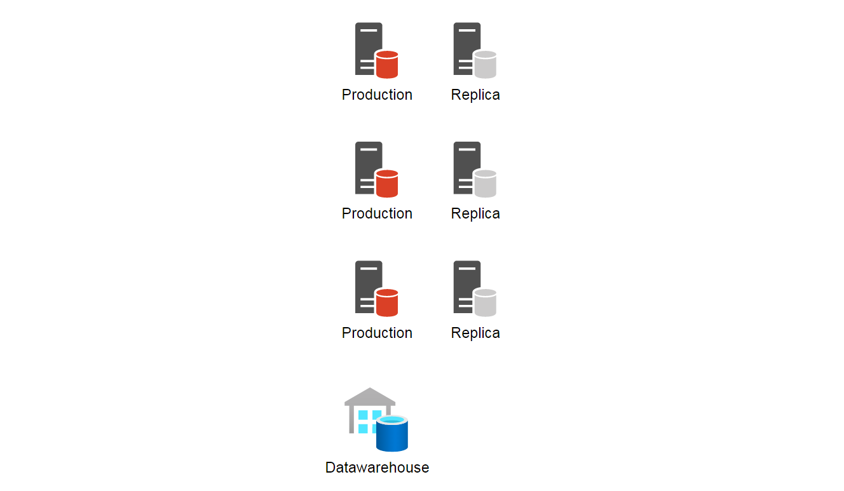
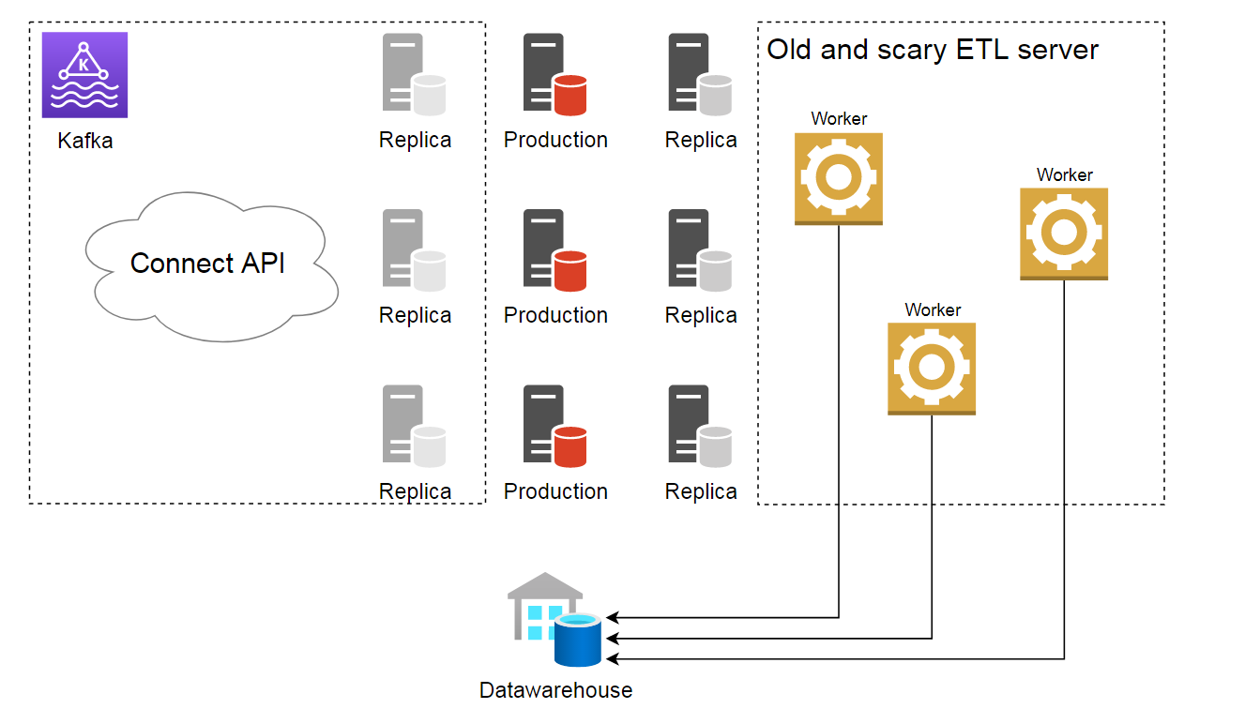
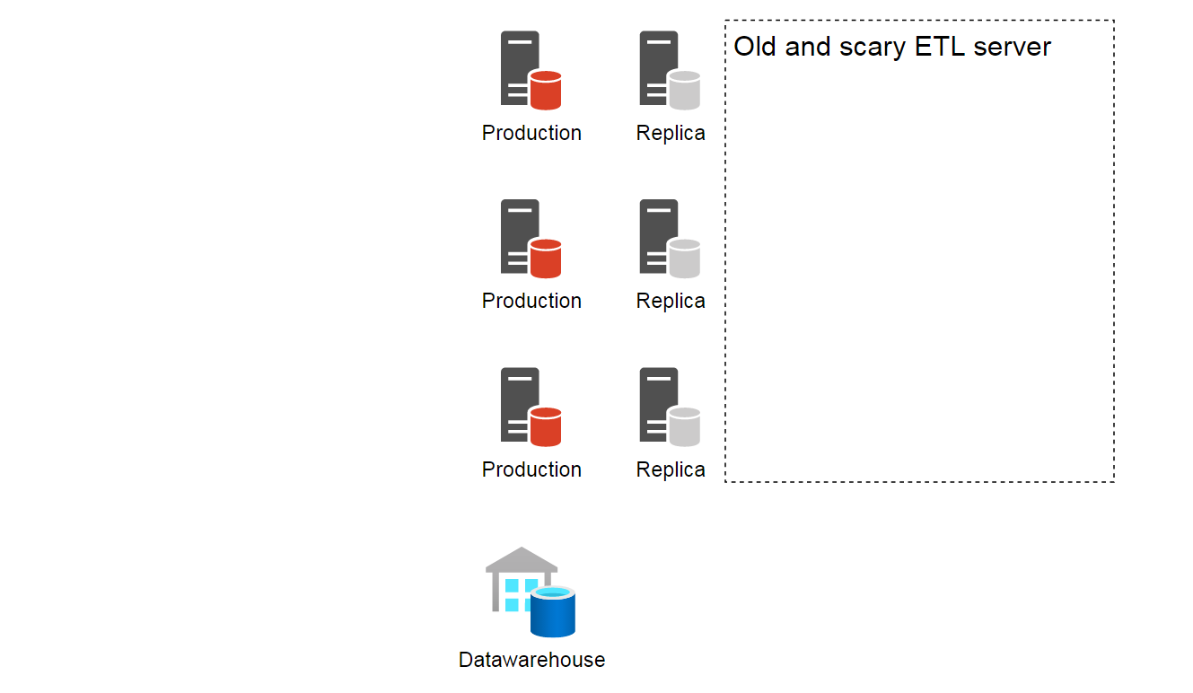
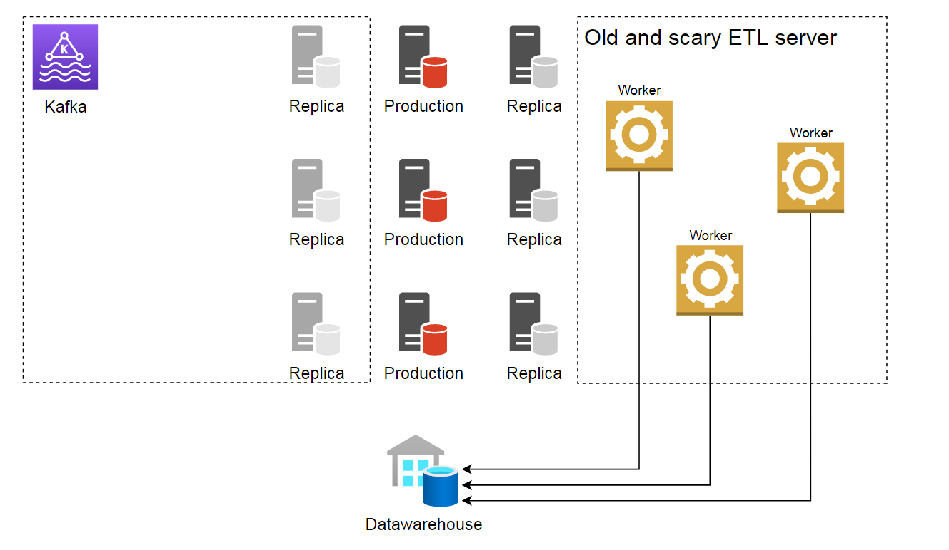
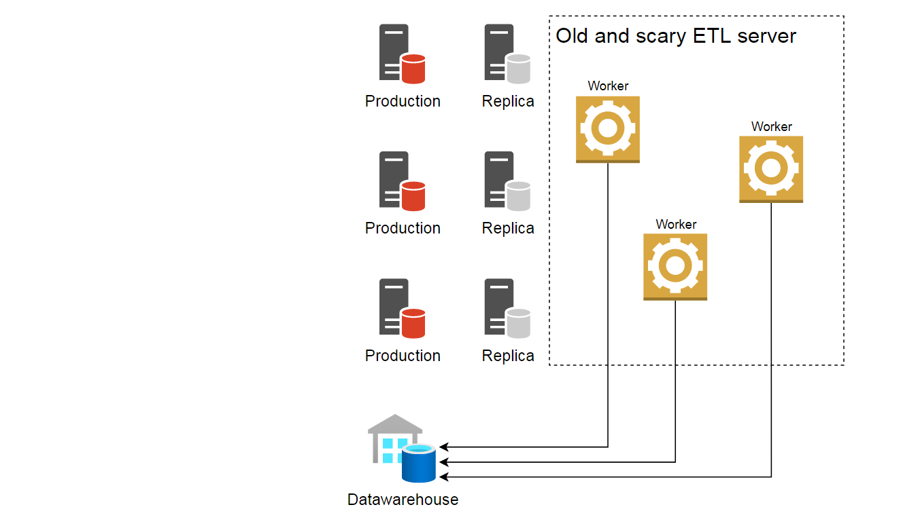

Creating of near real time datawarehouse or how to trick your DBA with a fake replication server

Slide 14
Extending Kafka: Kafka Streams
Once you want to do data processing, you need to consume it first
  Do you?
  What if all data you need is already in Kafka?
Kafka Streams allows to run data processing inside Kafka
Write Streams app in Java and let Kafka handle operational load

Slide 15
Kafka Streams: Define time
Event time
  Created “at the source”
Log append or ingestion time
  When message is written into a topic partition
Processing time
  When message is being consumed by Streams app
  It can be milliseconds or hours and days greater than event time
  Not really reliable

Slide 16
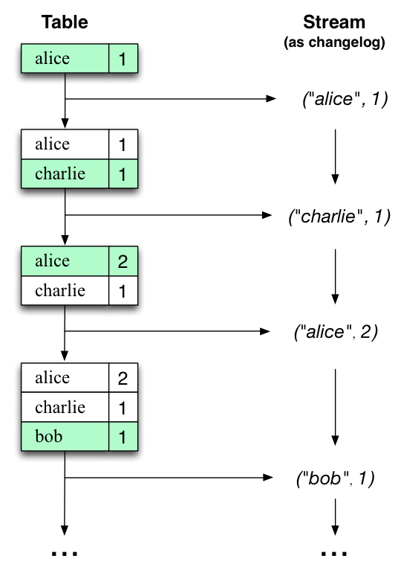
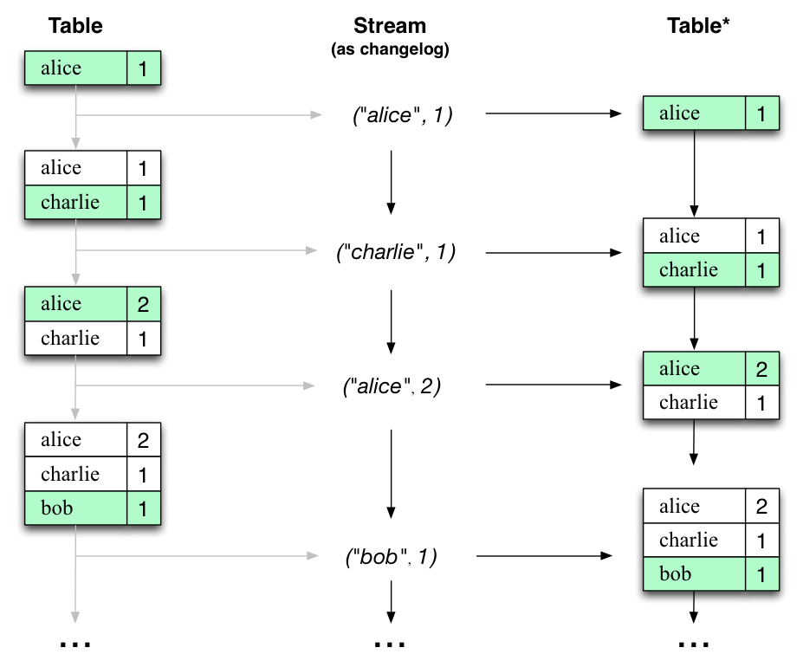
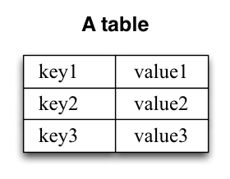
Kafka Streams: Stream-Table duality

Slide 17
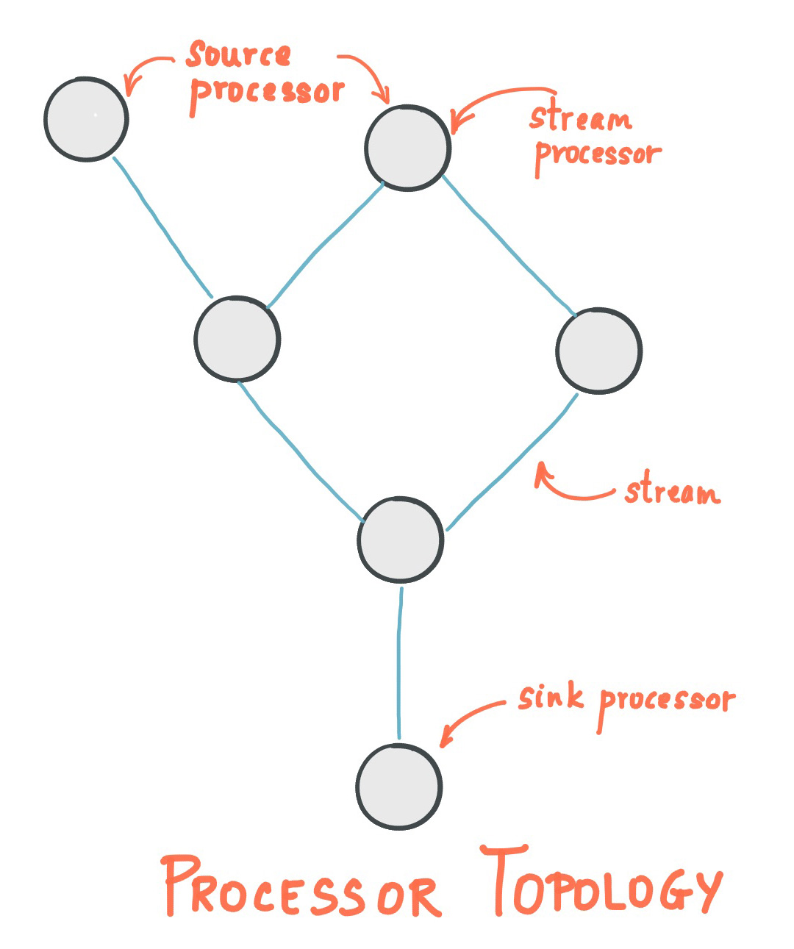
Kafka Streams: Processor Topology
Read from Source processor
Write into Sink processor
Transform in Stream processor
  Streams DSL is available in Java: map, filter, join
  Aggregations are also possible
  Windowing with a grace period
  State stores: persistent key-value or in-memory hashmap or else

Slide 18

Aggregating Wikipedia events: demo app
https://github.com/ilia-khaustov/sytac-devjam2021-wikiapp

